Slide 1
AI vs. Human: Academic Essay Authenticity Challenge
PIP2001 Capstone Project
FINAL VIVA-VOCE
Batch Number: CST-G09
Roll Number | Student Name
20211CST0067 | WARALE AVINASH KALYAN
20211CST0059 | SIDDHARTH PAGARIA
20211CST0076 | CHAITRA V
20211CST0085 | SPOORTHI HG
Under the Supervision of,
Dr. Sandeep Albert
Assistant Professor
School of Computer Science and Engineering
Presidency University
Name of the Program: B.Tech Computer Science Technology (AI & ML)
Name of the HoD: Dr. Saira Banu
Name of the Program Project Coordinator: Dr. H M Manjula (AP)
Name of the School Project Coordinators: Dr. Abdul Khadar A

Slide 2
Introduction
The rise of large language models (LLMs) like ChatGPT has introduced significant challenges in maintaining academic integrity. These AI systems can generate highly coherent essays, often indistinguishable from those written by students, raising concerns about the authenticity of academic submissions. To protect educational standards, it is critical to develop reliable methods for identifying machine-generated essays. This task becomes especially complex when dealing with essays authored by both native and non-native speakers, as well as those produced by various LLMs.
The goal of this research is to explore and implement effective detection techniques to distinguish human-written texts from AI-generated ones, ensuring fair and ethical academic practices in the age of advanced AI.

Slide 3
Literature Review
The rapid advancement of AI-generated text, particularly with models like ChatGPT, has raised questions about the authenticity of academic writing. Researchers have explored various methods to identify AI-generated essays, focusing primarily on linguistic features and machine learning techniques. Studies show that AI-generated content often differs from human writing in terms of lexical diversity, sentence structure, and coherence. AI essays tend to be more formulaic and lack the nuanced discourse markers that are naturally present in human writing.
Several approaches have been developed to address this issue, including the use of Support Vector Machines (SVM), N-gram analysis and other classifiers to detect specific linguistic patterns in AI-generated texts. Tools like GPTZero and other detection software have demonstrated success in identifying AI content but face challenges with paraphrased or rephrased text. More recent studies suggest that combining linguistic analysis with machine learning models can significantly improve the accuracy of detecting AI-generated essays, especially when dealing with non-native speakers or subtle variations in writing style.
Another key finding from the literature is that while AI-generated essays can be detected with reasonable accuracy, there is still a risk of misclassifying genuine student work as AI-generated. This highlights the need for more refined detection methods that minimize false positives, ensuring fairness in academic evaluations.

Slide 4
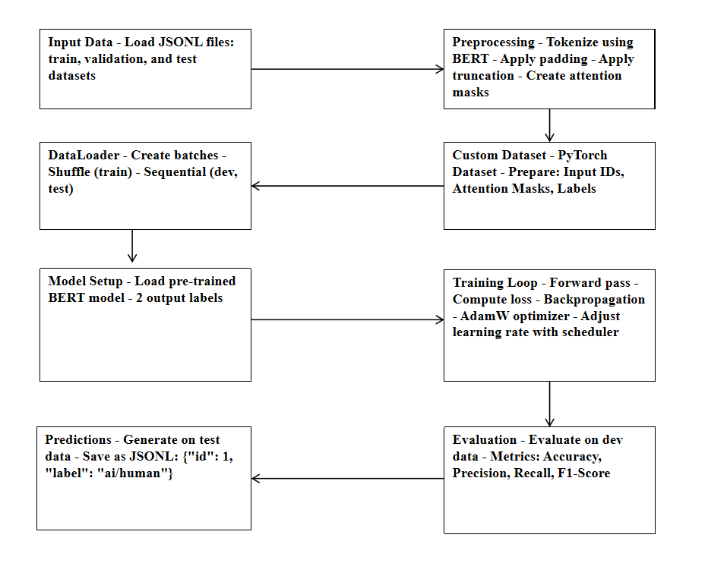
Proposed Method

Slide 5
Objectives
Developing a Binary Classification Model: Creating a system that accurately classifies essays as either human-written or machine-generated, using features that capture key differences between human and AI-authored texts.
Analyze Writing Patterns Across Different LLMs: Performing a detailed analysis of essays generated by various large language models (LLMs) used to identify and distinguish characteristics that can be used to enhance detection accuracy.
Enhancing Detection Accuracy: Focusing on detecting minute differences in writing style and language usage that help distinguish human essays from those generated by machines, even when the text appears fluent and well-structured.
Ensure Robust Classification Across Diverse Inputs: A robust classification system that performs reliably across a diverse range of essay topics, writing styles, and proficiency levels which supports academic integrity.

Slide 6
Methodology
1. Problem Formulation
Objective: Distinguish between human-authored and machine-generated essays.
Goal: Safeguard academic integrity and prevent misuse of large language models.
Task: Binary classification of essays into "Human" or "AI."
2. Data Collection & Preprocessing
Data Collection: Use diverse text corpus (human and machine-generated essays) with annotation tools.
Preprocessing: Tokenization, stemming.
Storage: Store data in cloud databases for scalability and accessibility.
3. Feature Engineering
Features: Linguistic (lexical diversity), stylistic (sentence length, grammar), and machine learning features (TF-IDF, n-grams).

Slide 7
Methodology
4. Model Selection & Training
Models: Train using ML frameworks (e.g., PyTorch) with pre-trained models for deep learning.
Resources: Utilize cloud computing resources (e.g., Google Cloud) for scalable model training.
Evaluation: Evaluate with metrics like accuracy, precision, recall using built-in evaluation tools.
5. Model Deployment & Maintenance
Deployment: Use model serving platforms (e.g.Streamlit) for real-time deployment in a scalable environment.
Monitoring & Maintenance: Implement logging and model updating pipelines to handle new data and ensure continuous performance.
6. Ethical Considerations
Address privacy and bias concerns, ensuring secure data handling in the cloud and ethical AI use.

Slide 8
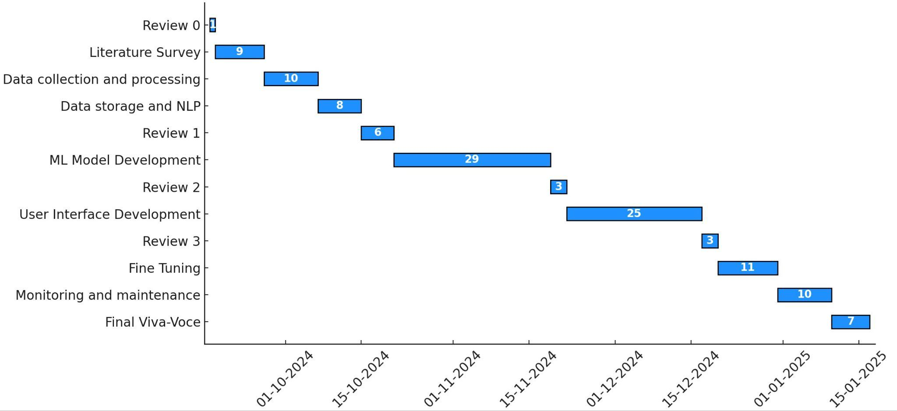
Timeline of Project

Slide 9
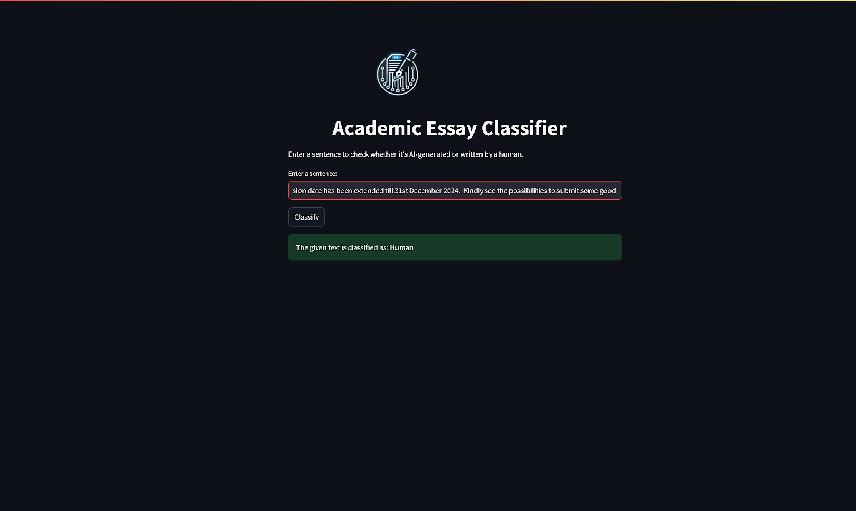
Outputs

Slide 10
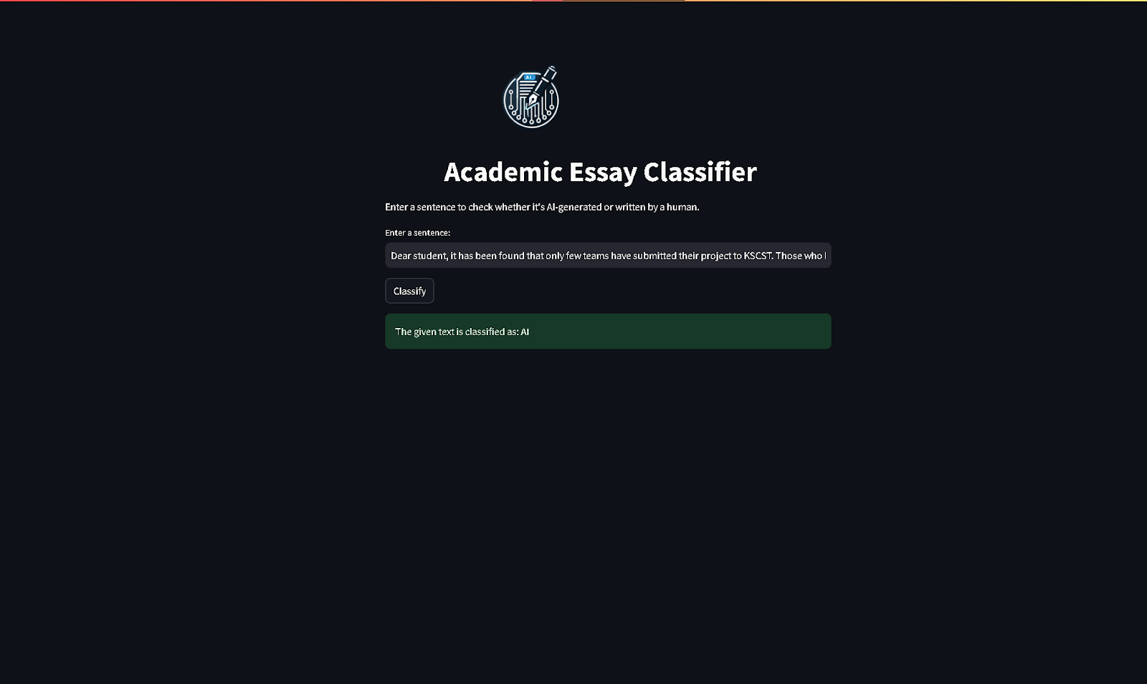

Slide 11
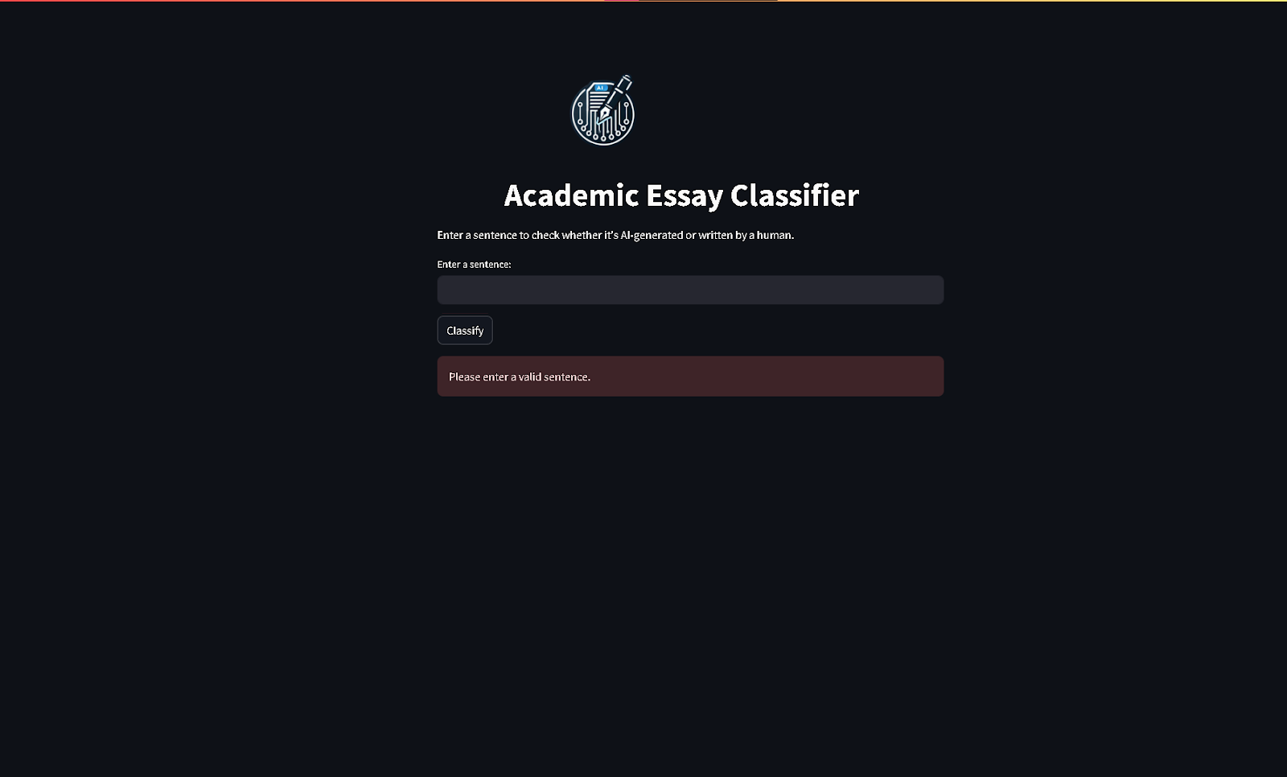

Slide 12
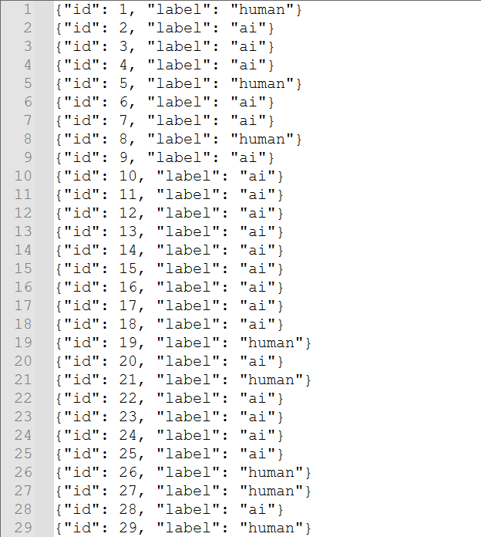

Slide 13
Future Work
1. Model Improvement
Further fine-tune the model on domain-specific datasets.
Extend the model to multi-lingual support and more robust explainability techniques.
2. Dataset Enhancement
Curate a larger, diverse dataset covering various domains and languages.
Include paraphrased and rephrased AI-generated content for robust detection.
3. Integration with Advanced Tools
Explore the inclusion of LangChain to enhance the pipeline with multi-step reasoning and contextual analysis.
4. Deployment and Accessibility
Develop mobile-friendly and user-friendly applications for real-time detection.
Integrate with educational platforms to provide real-time feedback on submissions.

Slide 14
Conclusion
In an era where AI-generated text is becoming increasingly sophisticated, the need to safeguard academic integrity is more pressing than ever. This project explored the challenges posed by tools like ChatGPT, which can produce essays that closely mimic human writing, making it difficult to differentiate between genuine student submissions and AI-generated content. By utilizing machine learning classifiers and linguistic analysis, we aimed to develop a reliable detection framework that can accurately identify AI-generated essays without falsely accusing human authors.
The results of this research demonstrate the potential of combining machine learning models with linguistic feature analysis to create a more accurate and robust detection system. However, as AI continues to evolve, so too must our methods of detection. Educational institutions will need to continuously adapt their approaches, not only to keep pace with advancements in AI but also to rethink how assessments and academic practices are conducted in this new digital landscape.
In the end, while technology like AI can be a powerful tool in education, it is crucial to balance its benefits with ethical considerations, ensuring that academic integrity remains intact. This project offers a step forward in preserving the authenticity of academic work, paving the way for future research and solutions in this evolving field.

Slide 15
References (IEEE Paper format)
Cingillioglu, I. (2023). Detecting AI-generated essays: The ChatGPT challenge. The International Journal of Information and Learning Technology. https://doi.org/10.1108/IJILT-03-2023-0043
Walters, W. H. (2023). The effectiveness of software designed to detect AI-generated writing: A comparison of 16 AI text detectors. Open Information Science. https://doi.org/10.1515/opis-2022-0158
Liu, Y., Zhang, Z., Zhang, W., Yue, S., Zhao, X., Cheng, X., Zhang, Y., & Hu, H. (2023). ArguGPT: Evaluating, understanding, and identifying argumentative essays generated by GPT models. ArXiv. https://arxiv.org/abs/2304.07666
Dergaa, I., Chamari, K., Żmijewski, P., & Ben Saad, H. (2023). From human writing to artificial intelligence generated text: Examining the prospects and potential threats of ChatGPT in academic writing. Biology of Sport. https://www.ncbi.nlm.nih.gov/pmc/articles/PMC10108763/
Corizzo, R., & Leal-Arenas, S. (2023). One-class learning for AI-generated essay detection. Applied Sciences, 13(13), 7901. https://www.mdpi.com/2076-3417/13/13/7901

Slide 16
Thank You

